Slide 1

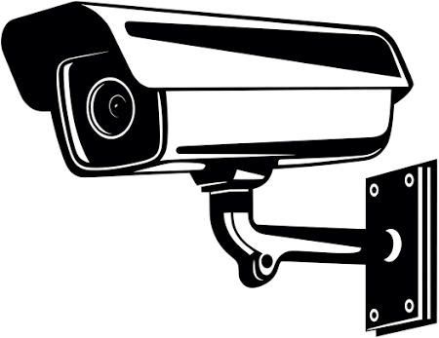
Class View ID
Presented By:
By: Aden, Anthony, George, Thomas

Slide 2

Identified Need and Proposal:
The Problem we had identified was that schools needed a more efficient way to mark attendance, with current role making taking time away from learning and sometimes not even being done at all, or being left till the last minute.
Our solution to this problem is a door handle/knob that tracks attendance based on biometrics.
Thomas

Slide 3
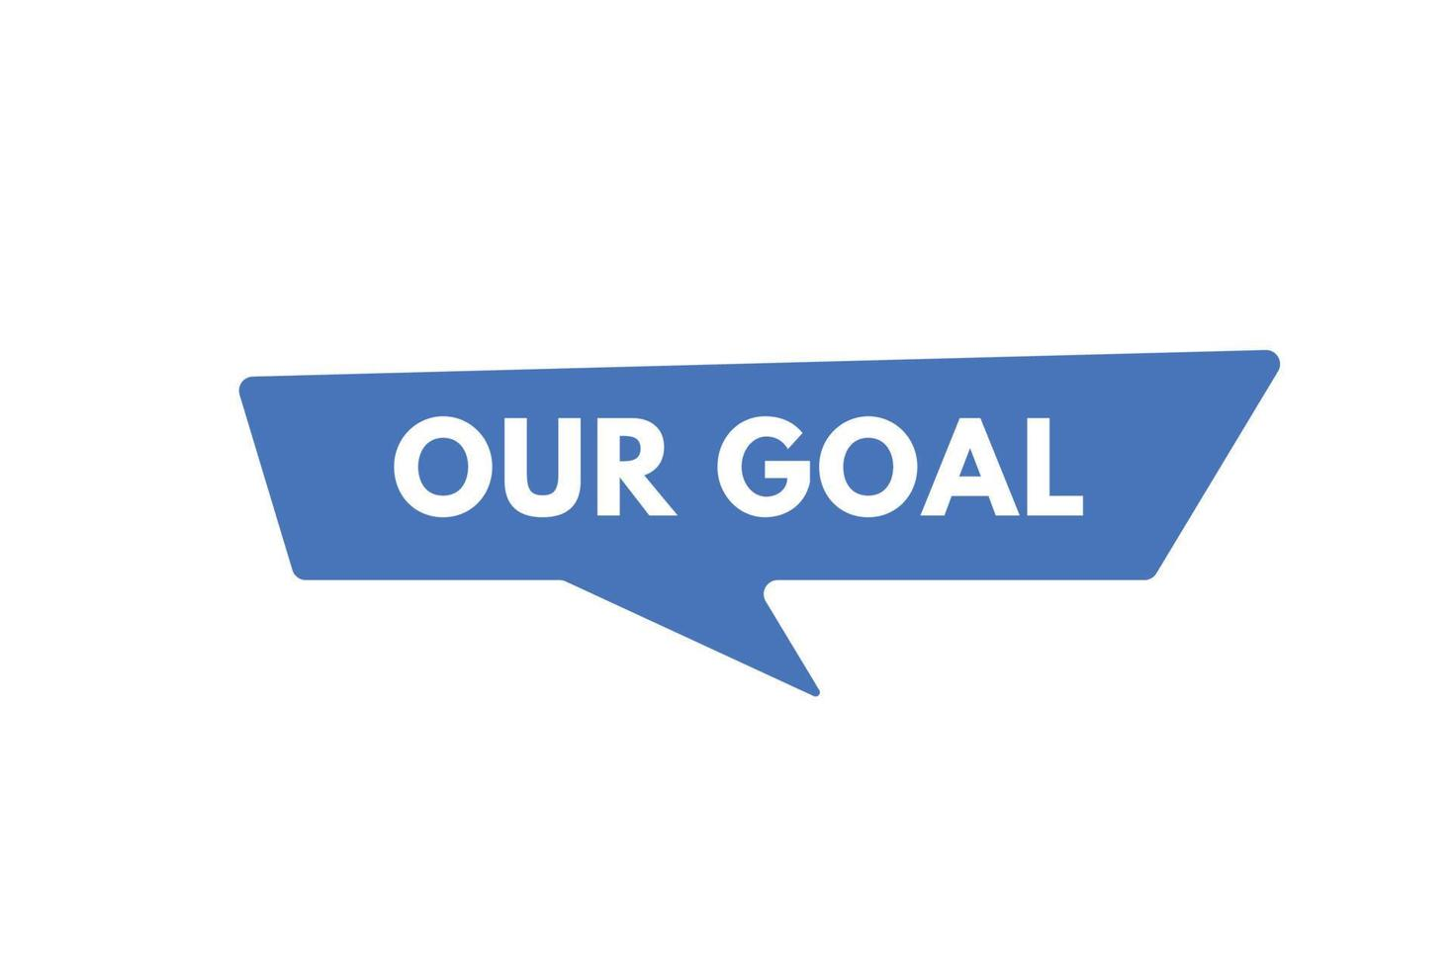
Inspiration:
What inspired us to make this?:
Iphone biometric systems
Teachers marking the role late or not marking it at all
Our Goal?:
We want to make it really simple for the school to get accurate and fast attendance results.
Thomas

Slide 4

Questions We Had:
Thomas
What are biometric systems?
Definition: Biometric systems use physical traits (e.g., fingerprints, face, hand geometry) to identify people.
What is facial recognition?
Definition: Computer vision technology that scans and matches facial features using machine learning algorithms.
Functional and Non-functional requirements:
Functional – What the system must do (e.g., mark attendance).
Non-functional – How well it performs (e.g., fast, secure, reliable).

Slide 5
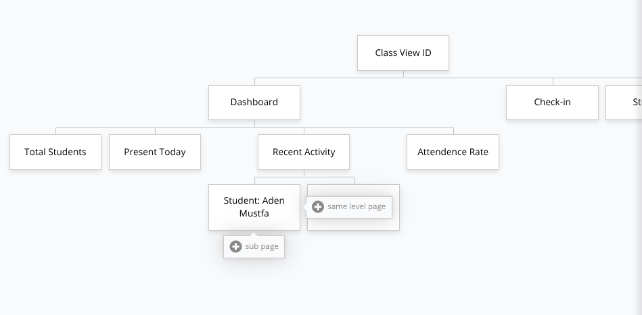
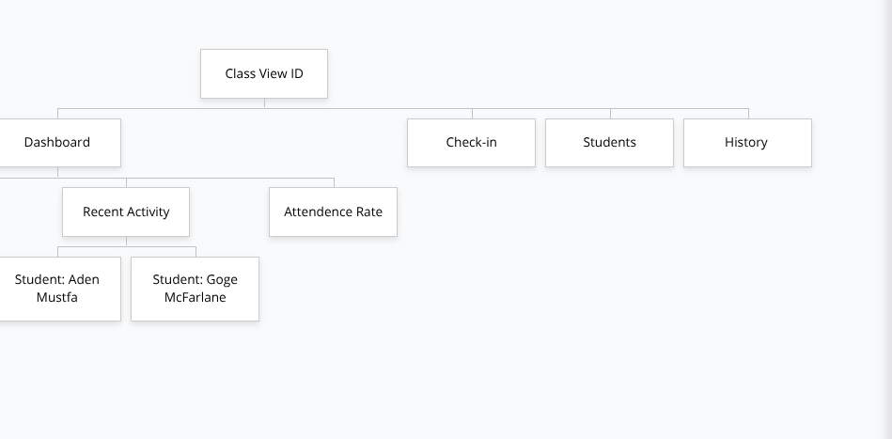
Wire Frame from Gloo Maps:
Thomas

Slide 6
Functional Requirements:
Anthony
FR01 - Logging user attendance: Capture a picture of the students face, that is stored in some type of encrypted system, with the image information relating to student data.
FR02 - Automatic Attendance Marking: Automatically mark the attendance when the system scans the users face.
FR03 - Multi-Modal Support: The System should be able to work with either fingerprint or photo ID, depending on which is able to work or not.

Slide 7

Non-Functional Requirements:
George
Response time being 2 seconds or less, after scanning a face. (Why Non-functional: We chose to make this a Non-functional requirement as it is not a necessity, in order to have a working device, it just makes the process more convenient.)
Fail Safe Mode: If either of the Scanners fail, then it would send an error notification to either the office, or to the classroom teacher so they can manually mark the roll. (Why Non-functional: We decided this was a Non-functional requirement, as it is not required to make the product, and is again another convenience option.)
Expandability: Product should be able to be easily expanded into other classrooms without becoming slow or over crowded. (Why Non-functional: We decided to make this a Non-function requirement, because it is not needed to make a fully working device. It would be useful, but not necessary.)
The data is available to the teachers and office staff. (Why Non-functional: This was decided to be a Non-functional requirement, as it is not really as necessary to have a working product it would be needed if placed in schools)
Error troubleshooting: The system should have some kind of way to troubleshoot, to see what problems may be affecting the attendance system. (Why Non-functional: The reason we made this a Non-functional requirement is because it would be better suited to be put into a future model of this project as it is not required for it to function.)

Slide 8
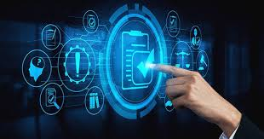
Aden
List of Non-Functional Requirements Becoming Functional Requirements (For Future Models):
Fail Safe Mode: If either of the Scanners fail, then it would send an error notification to either the office, or to the classroom teacher so they can manually mark the roll: After designing the product, we decided that if we were to create a new and improved version of our product, it should include a failsafe mode in case the system goes down for whatever reason; which would allow for more versatility when it comes to working with and around the system, as well as its features.
Response time being 2 seconds and less, after scanning a fingerprint or scanning a face: After creating the product, we decided that we should include the response time to be 2 changed seconds or less, to allow for better response time. Making the newer version of our product more user friendly and time effective.

Slide 9
The Constraints of This Project:
Anthony
Python must be used as the coding language.
Needs to be compatible with Google Sheets, Microsoft Excel and/or Microsoft Access.
Biometric data must be in line with the laws regarding biometric data in schools.
Must be able to run on already existing school set-ups.
Must be done with the Unit 2 time frame.
Needs to be able to function in temperatures from 5 Degrees Celsius to 35 Degrees Celsius.
Should be able to survive low level physical damage, as well as not be affected too heavily by dust.
Must document all tasks done and not done in either Google Docs, Google Sheets, On a physical piece of paper or on any other recordable means.
Must be uploaded to the GitHub repository.
Code must be written in pseudo code, so as to be easily adapted into proper code by a coder, and easily understood by those who don’t understand python code.

Slide 10

Pseudocode:
George
This was the first attempt at pseudo code, it was done within the first week of coming up with our idea, and as you can see it isn't very detailed.
Start
If camera detect student in list(attendance)
Beep 1
If not
beep 2
Alert teacher
Once
Class end
Change attendance list to next class
Repeat
If student leave class
Mark as left
If come back
Mark as back and how long they were gone for
If gone for 20>
Alert teacher

Slide 11

George
Useful links/videos/websites:
How to create a finger scanning system in python:
Description: This video shares how to create fingerprint recognition using python (Should work in Thonny).
https://www.youtube.com/watch?v=IIvfqfKkiio
How to create a finger scanner system in arduino:
Description: Same as the video above but for arduino.
https://www.youtube.com/watch?v=X6WnkEh0kHU
How does facial recognition work:
Description: Detailed video of how facial recognition works.
https://www.youtube.com/watch?v=9H72QbYqxXU
How does fingerprint recognition work:
Description: Detailed video of how fingerprint recognition works.
https://www.youtube.com/watch?v=BW2c-AlQkME
Video about facial recognition in Python:
Description: This video covers the basics of using facial recognition in python.
https://www.youtube.com/watch?v=Y0dLgtF4IHM
How to scan fingerprints in Arduino:
Description: This video covers the basics of how to scan a fingerprint using Arduino.
https://www.youtube.com/watch?v=3CdYJlfRT4M
How to use the fingerprint Arduino Scanner:
Description: This video shows how to use an Arduino Scanner tool.
https://www.youtube.com/watch?v=ARCMkdLBLws&pp=0gcJCfwAo7VqN5tD
How to create a facial recognition system in python:
Description: This video shares how to create facial recognition using python (Should work in Thonny).
https://www.youtube.com/watch?v=vA-JiuYX--Y
How to create a facial recognition system in arduino:
Description: Same as the video above but for arduino.
https://www.youtube.com/watch?app=desktop&v=hldWNSvZf1Q

Slide 12

What is needed for ClassView ID:
George
Hardware (simulated or real):
Webcam or security camera
Button or some kind of RFID sensor (to simulate hand scan)
Wires to connect features together.
Ways to store/documentation:
Google Docs (for pseudocode, planning)
Diagrams (flowcharts, system layout)
Microsoft Excel (In database format)
Microsoft Access (In database format)
Software:
Python for the code
Possibly some kind of security system to protect the data
A face/fingerprint recognition library (Stores the data on students.)
Google Sheets (for attendance logs) Data will have to be exported onto compass, as compass is a closed app.
Tools:
Screwdriver
Wire strippers
Soldering iron and solder (optional)
Hot glue gun
Measuring tape or ruler

Slide 13
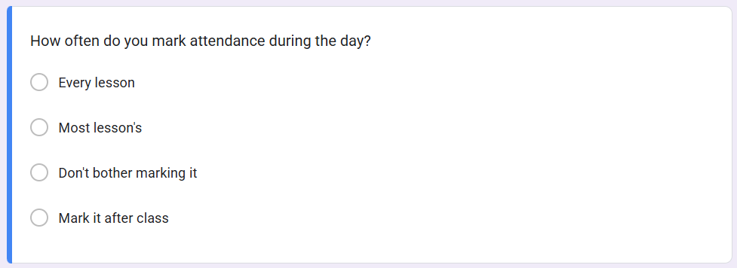
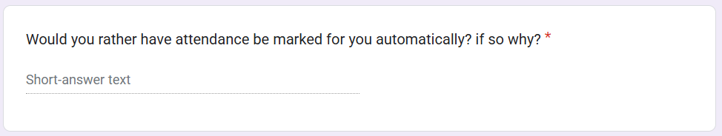
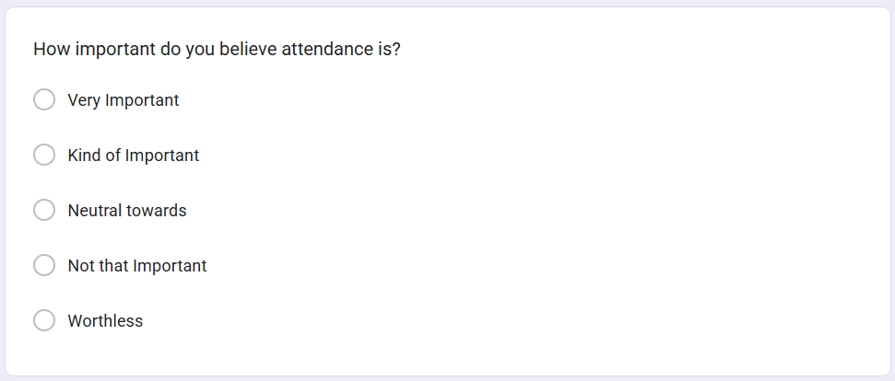
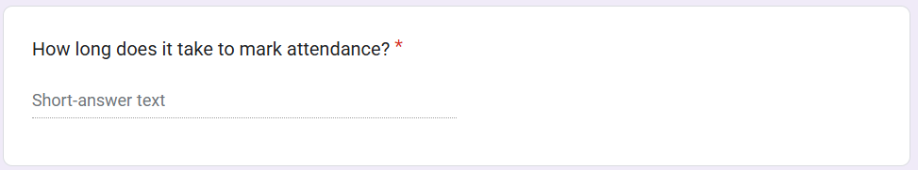
Surveys:
Data type: Quantitative.
Made to measure how often teachers mark the roll, with the question giving a percentage value for the answers.
Anthony
Data type: Qualitative.
Asks teachers if they would prefer for the role to be automatically marked, gives full answer.
Data type: Quantitative.
Made to measure how important teachers believe marking the role is, with the responses presented in a pie chart.
Data type: Qualitative.
Asks the teacher for the exact time value for how long they take to mark the roll, gives the full written answer.

Slide 14
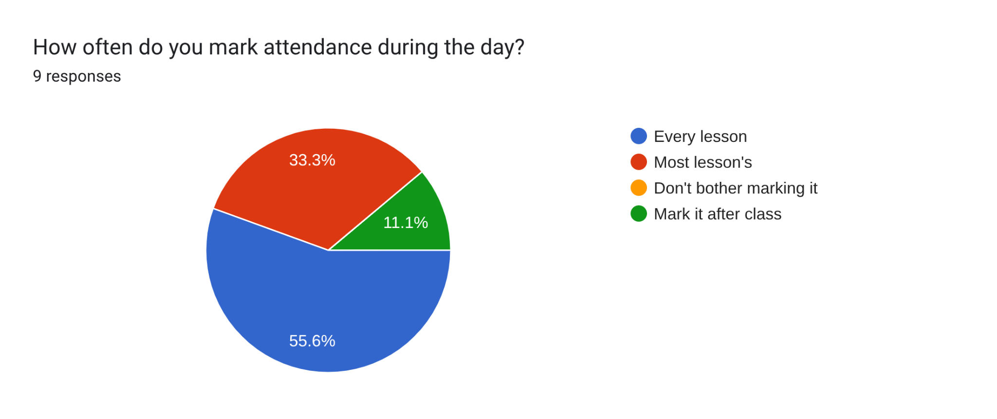
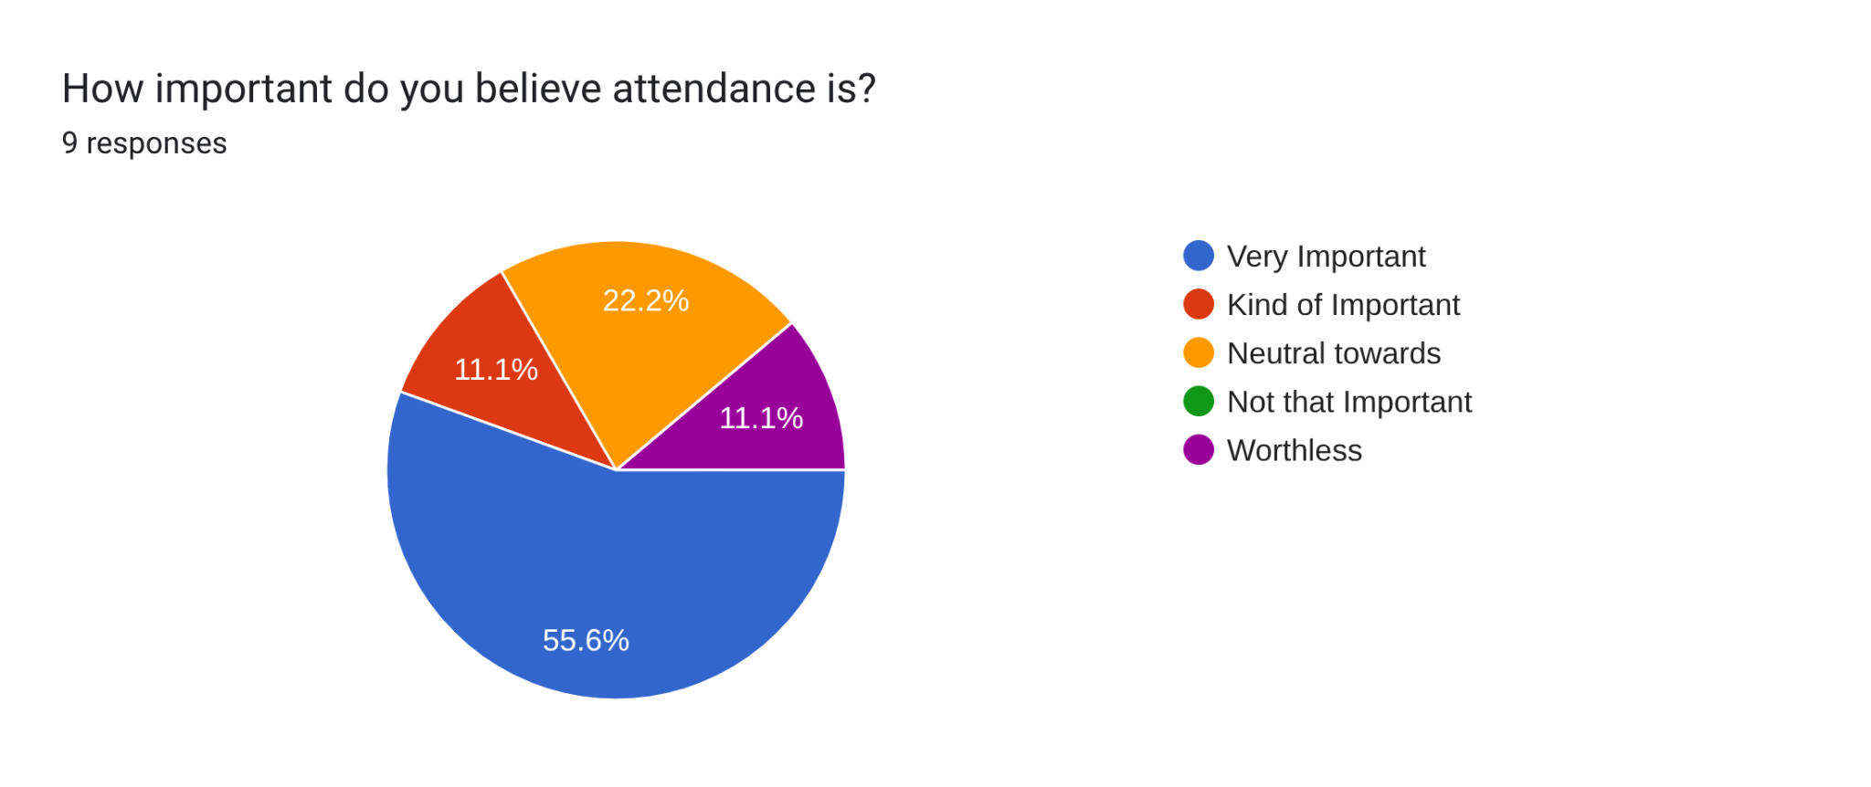
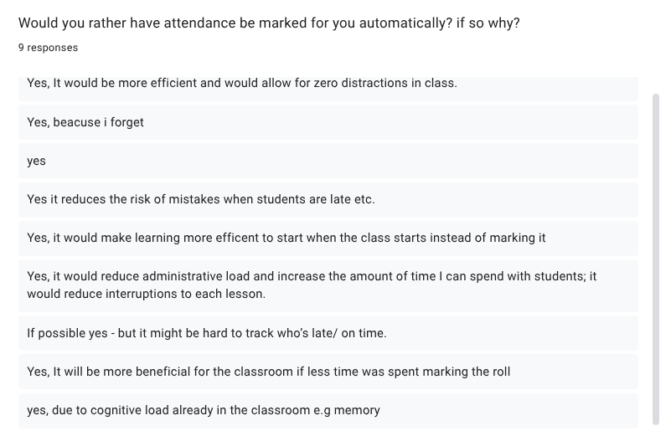
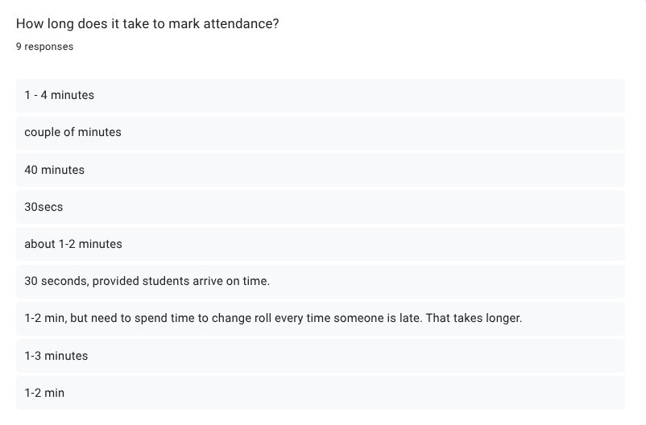
Survey Results:
Anthony

Slide 15
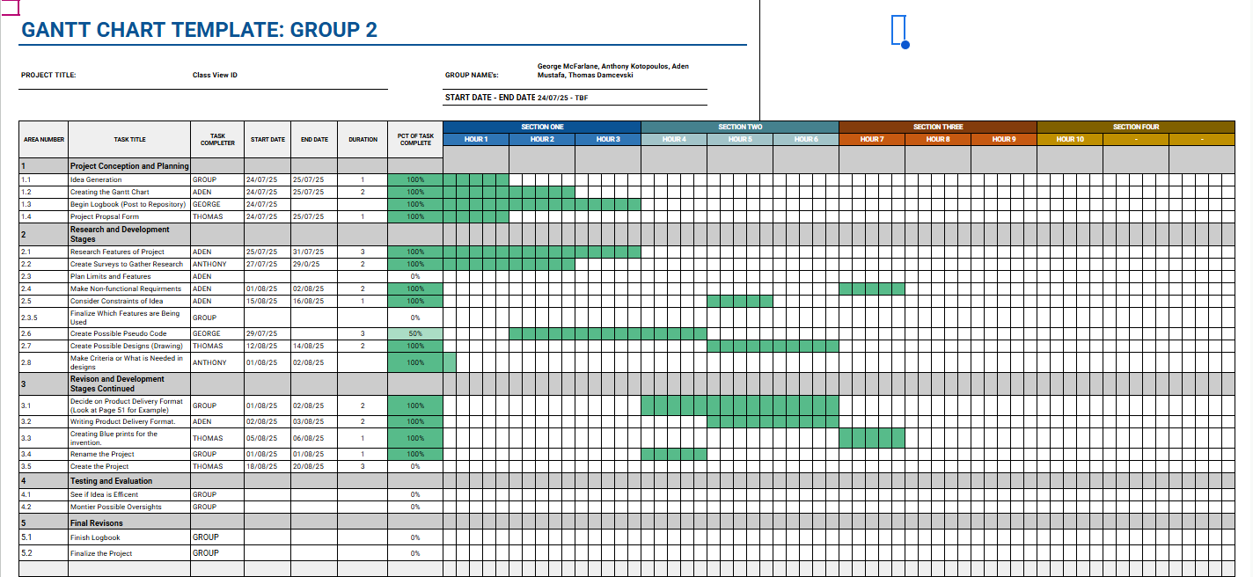
Halfway Mark Gantt Chart:
Aden

Slide 16

Initial Product Delivery Format:
Aden
When planning our delivery for our final project, we had to take into consideration many different factors like available knowledge, skills, and time constraints. Through these factors, we came to the conclusion that it would be best if we delivered a Mock-up / Model of our final product. We chose this option as it allowed us to show a general idea of what we wish to create; in a cheap, sustainable and relatively easy way. The specifics of the factors that affected the decision, is that when it comes to the knowledge, we don’t have as much mechanical knowledge that is required of the task. As for our skills, as a group, we have limited experience and skills in the mechanical department, with only one group member having a vague idea of what to do.
Finally, time constraints affect us by limiting how long we are able to spend on certain tasks. Because of this we opted to make a cardboard Model as it wouldn’t require as much time, due to the more given knowledge that our group had on working with different materials and tools, as well as having] someone with better artistic skills, that person being Thomas. Ultimately meaning we would have more time to spend on other applications, as well as removing some of the time strain brought on us during this project.
Using a Mock-up / Model allows for us to make cheaper versions of our product, that are easy to replace should a mistake be made, and/or a redesign is wanted or needed. Because of these factors, this is why we confidently chose to make a “Just for show version” instead of the full concept.

Slide 17

Final Product Delivery Format:
Aden
After some time has passed, and more knowledge and skills have been acquired by the team, we saw fit that we should change our final idea, for our Product Delivery Format.
Originally, we intended to create a simple Mock-up design for our project, as it fit well with the (At the time) current time constraints, current team skill level, and necessary costs. But with more time passing, (About a month and a half), the team had gained more skills, knowledge, and time to work on the project; Along with finding a way to get the necessary parts to make the camera in a cost effective way; we felt it would be a better idea to switch from a Mock-up design to a working Prototype.
Having a Prototype over a Mock-up gives us the opportunity to show off a working product, as opposed to a more theoretically based Model. Despite the extra time needed to make a working Prototype, it was still the better choice due to the benefit of having a working example to show before the buyers; (The Class) Making the time constraint less relevant.

Slide 18
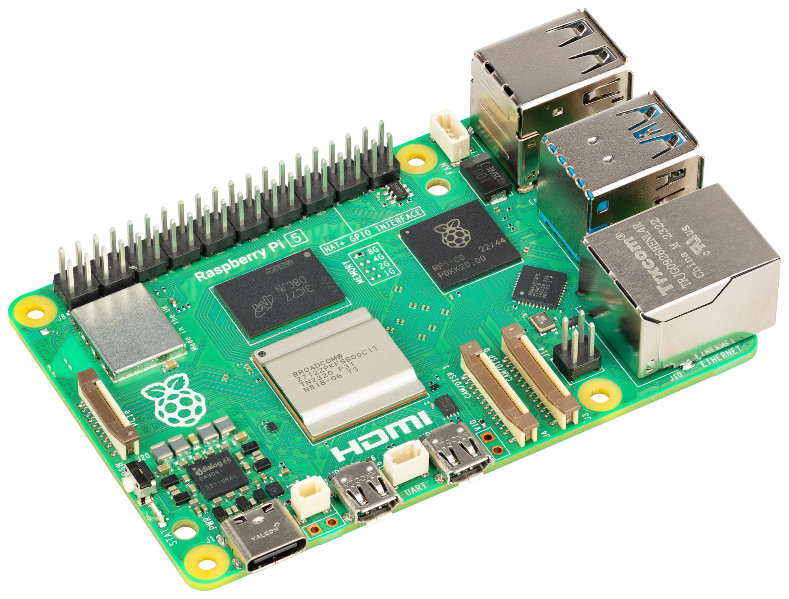
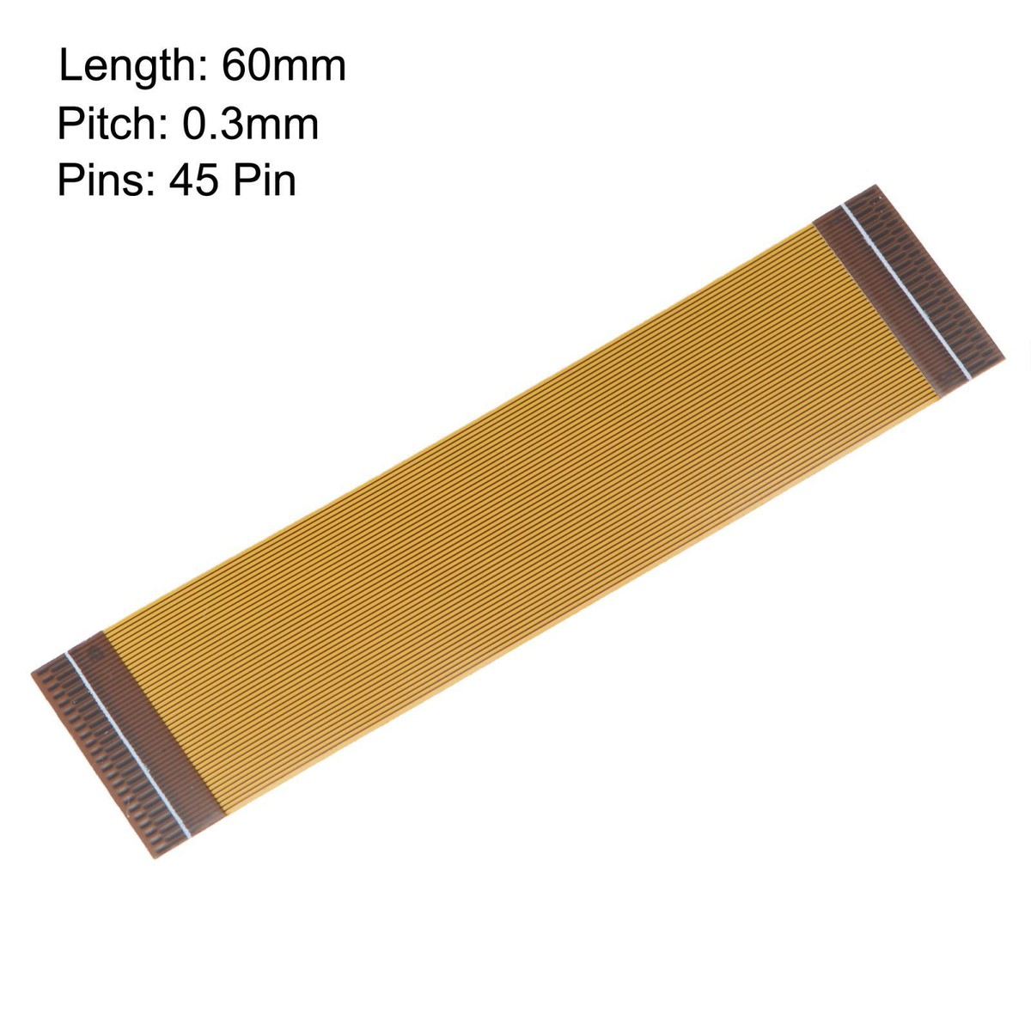
Ending Events:
Thomas
Towards the end of the Unit 2 time frame, we had a few unfortunate events happen to our group, which prevented us from getting the fully working project that we wanted.
The first event was our parts for camera that we were planning to use to build the camera, didn’t come with all of the parts that were necessary to build the actual camera. For example We had a Flat Ribbon which wasn’t a appropriate size, which meant we could not connect the camera to the PI. So we would either have to get a new cable, or get a new PI set.
The second event was our raspberry PI broke down. While we are unsure of what exactly happened, we are fairly confident that the old age of the Raspberry PI was the cause of this happening. Which meant at this point we needed both Raspberry Pi, as well as a Few Flat Ribbon.
The third, and most recent event was the software we were using required us to pay, so partway through creating our database we were forced to pay or abandon our project. A similar thing occurred when we went to other platforms. We do however have a prototype of what we would like to have done. We made this on thonny, with help from Chat-Gpt, Co-pilot
Unfortunately in the end, we weren’t able to get the website and raspberry pi
running, but we ended up getting a physical mock up and sketches done.

Slide 19
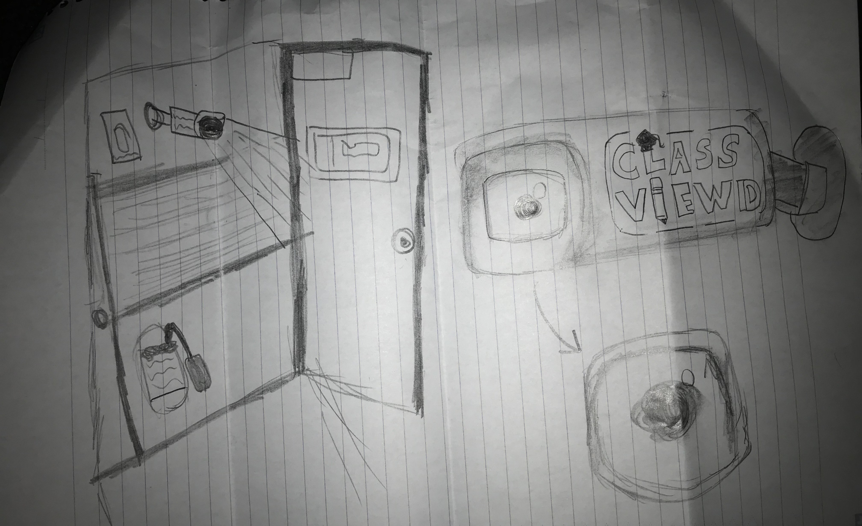
Thomas
Thankfully we were able to get sketches of what the final product would look like and how to would work.
I’ve also made a brototype of how the camera will look physically when the customer will purchase it
I've made this out of cardboard, the actual product will likely be made out of a type of plastic or metal so its sturdy and can withstand classroom activities and actions

Slide 20
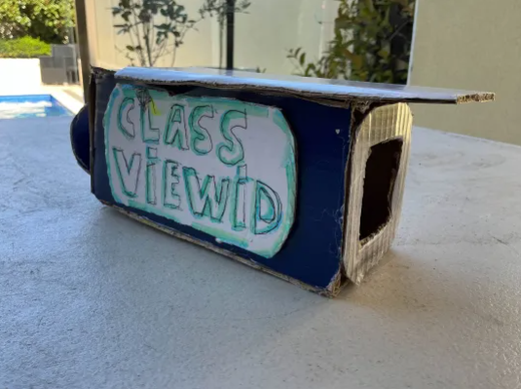
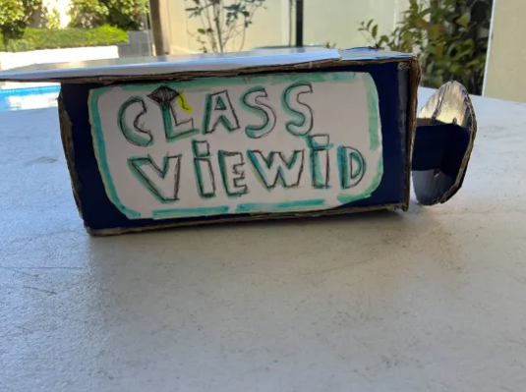
Thomas
Physical Camera:

Slide 21
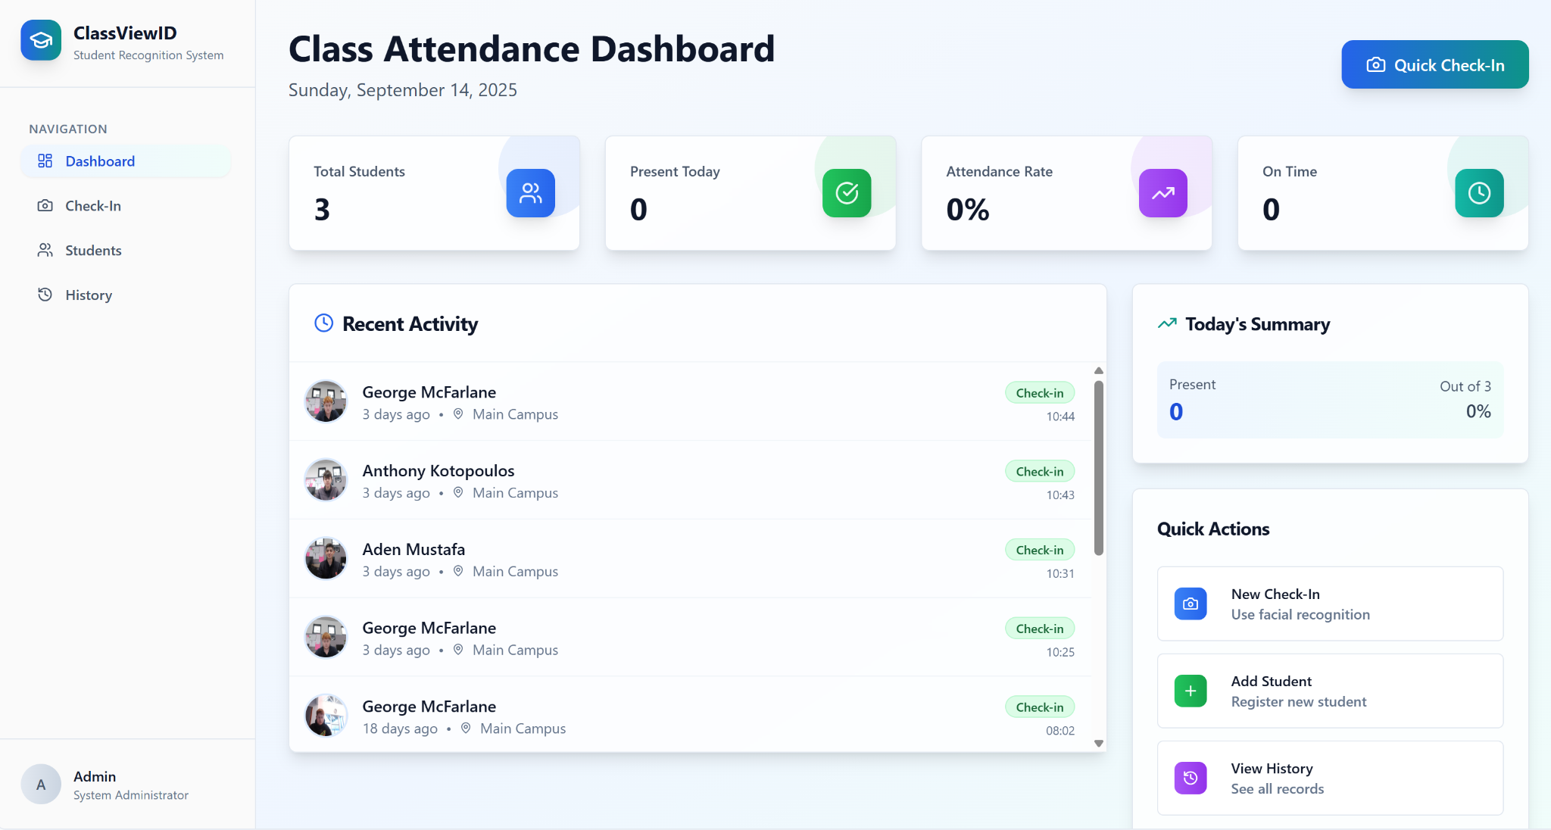
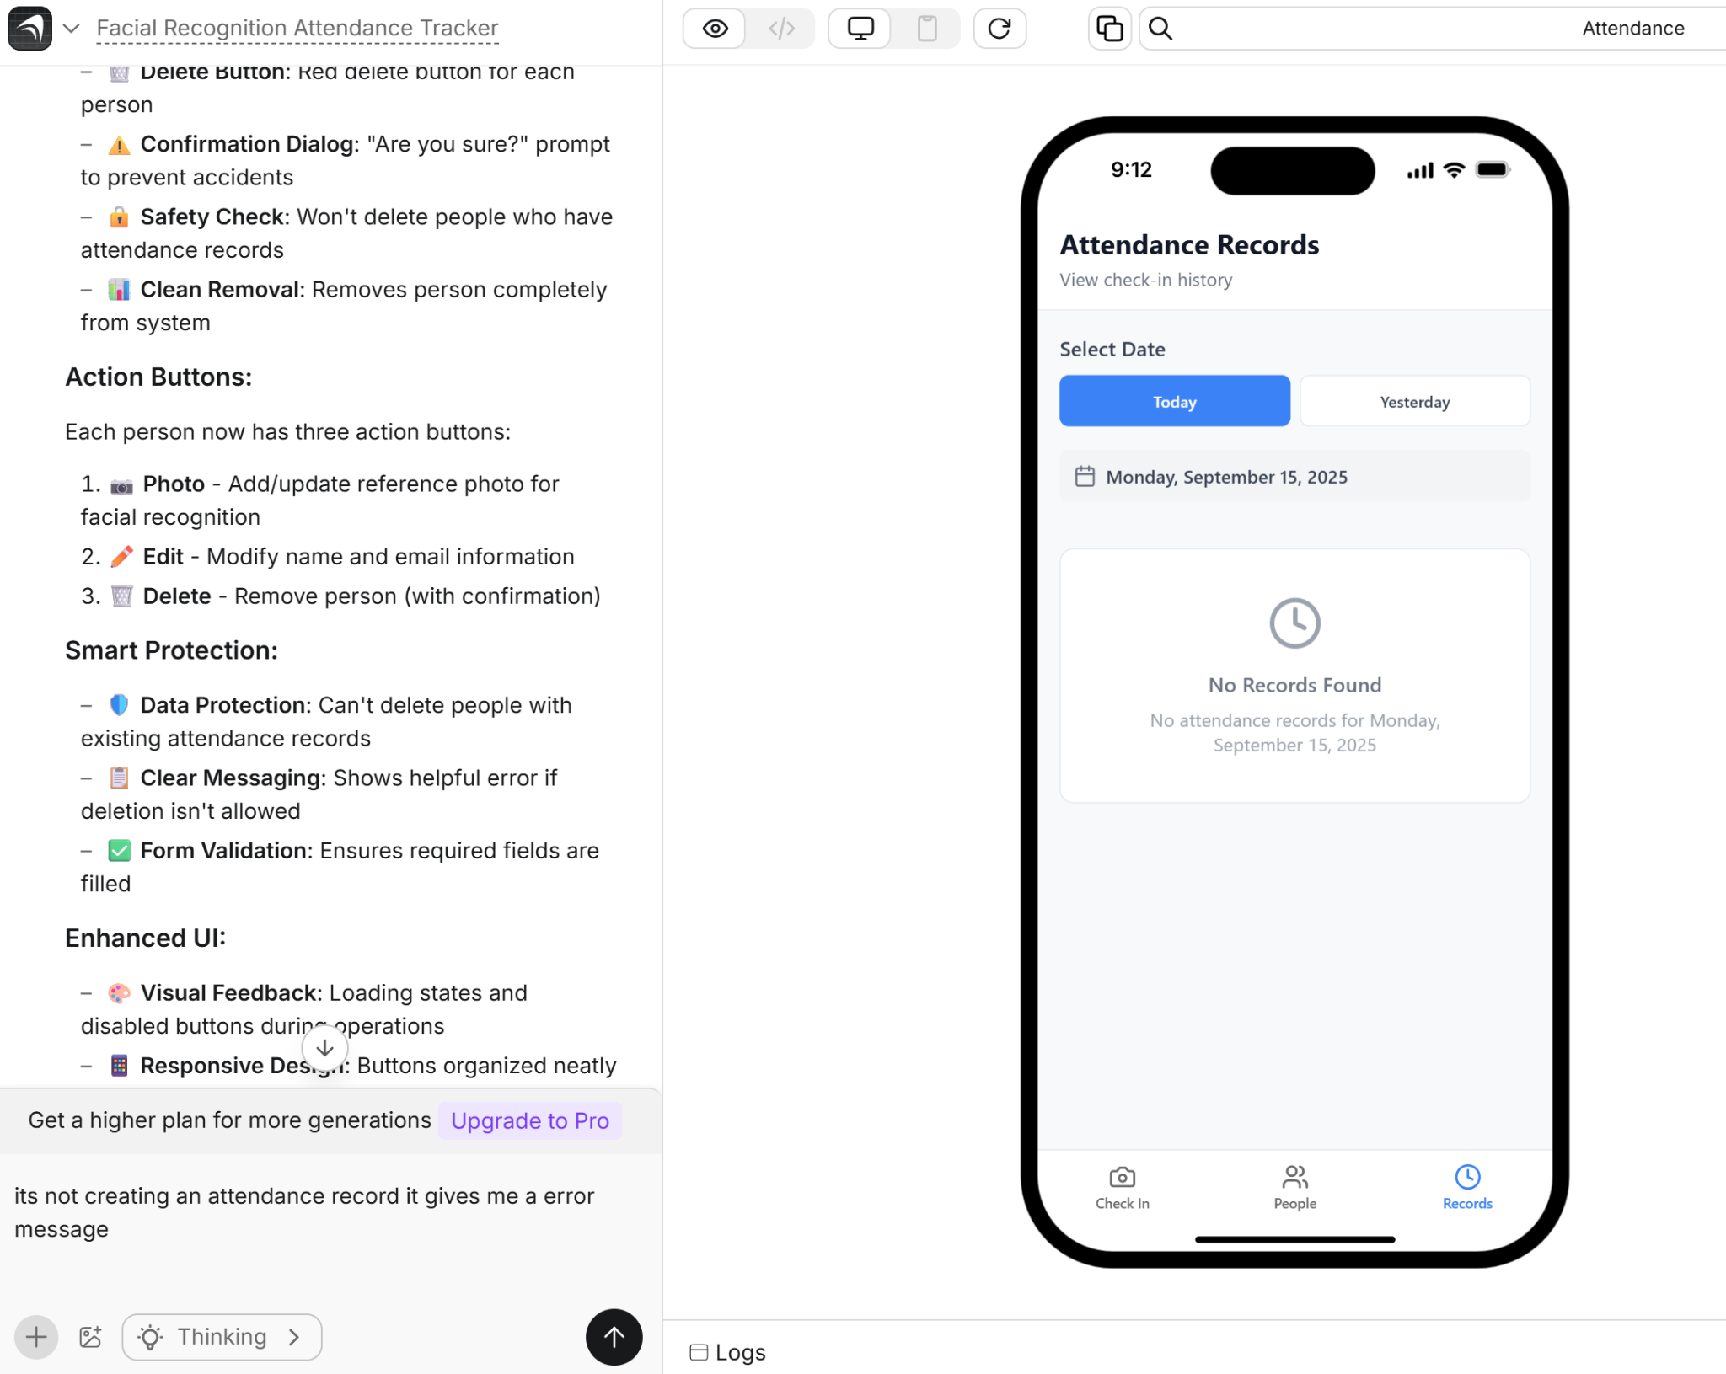
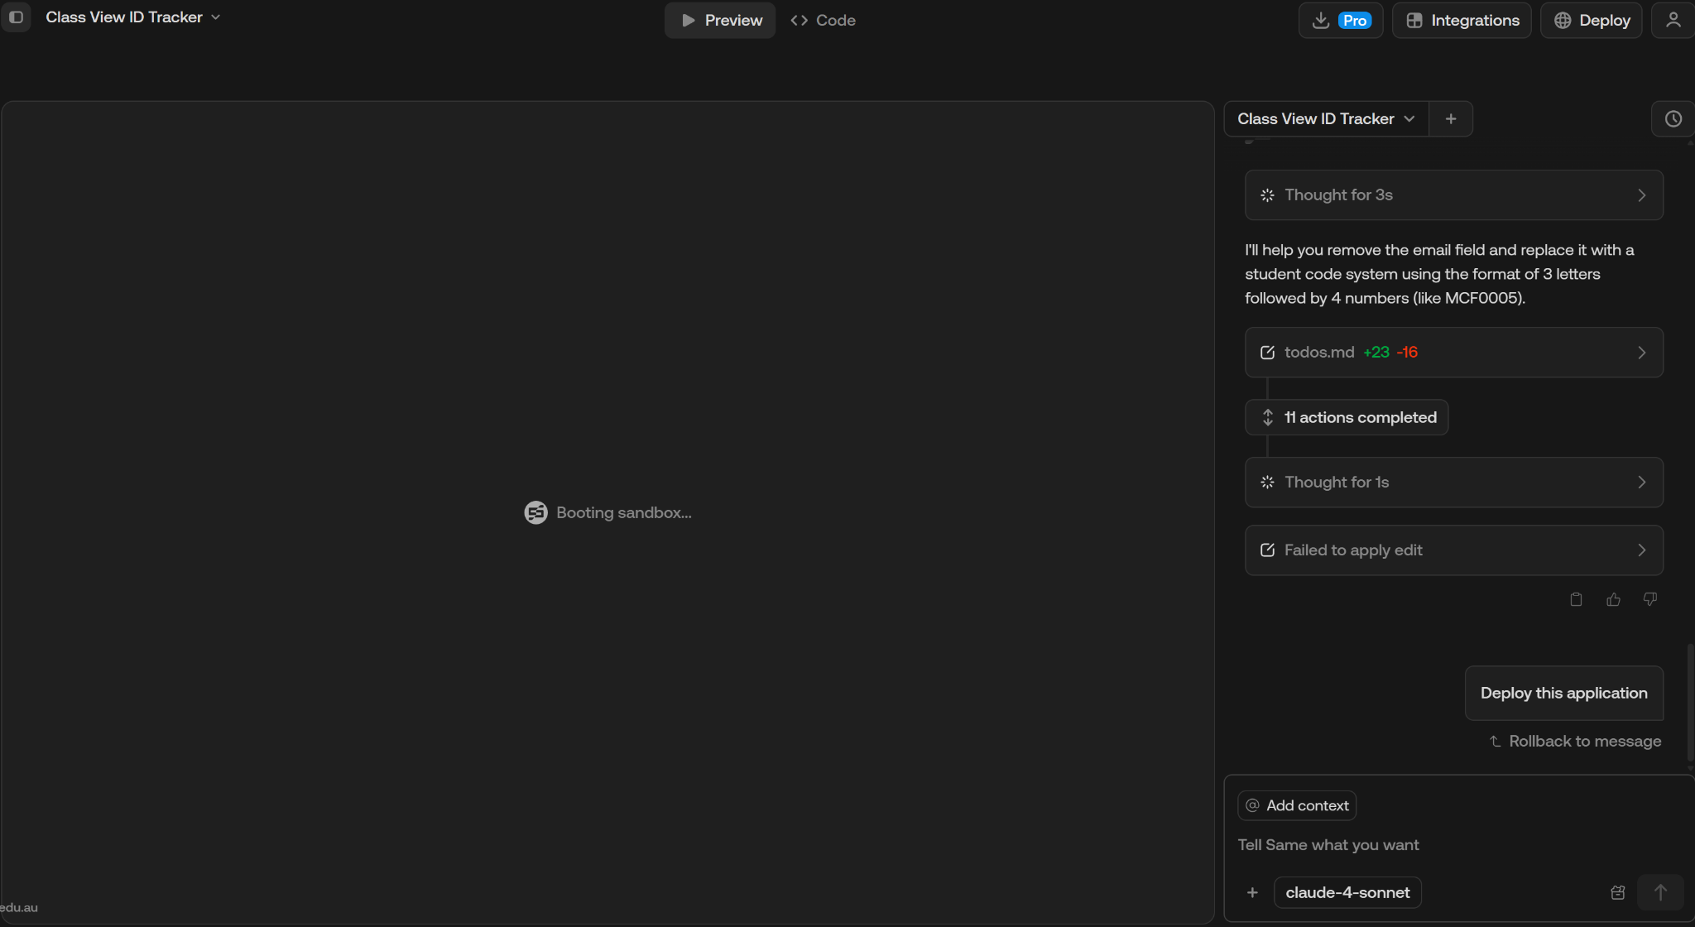
Failures with face ID:
George
After our Raspberry PI died, we decided that we would use an AI website builder to make a prototype; With base44 being our website of choice While it worked great at first, it didn't last long, as after about a week it decided to lock us out of the AI features with a paywall, with none of us willing to pay $20 USD a month, we had to switch, I went from website to website trying to find one that would work temporarily, even if it wasn't the best. But there was not one that could fulfill our needs. Even the recommended website form Cooper (createanything.com) didn't last long before it told me I had run out of credits.
Base 44
createanything.com
same.new

Slide 22
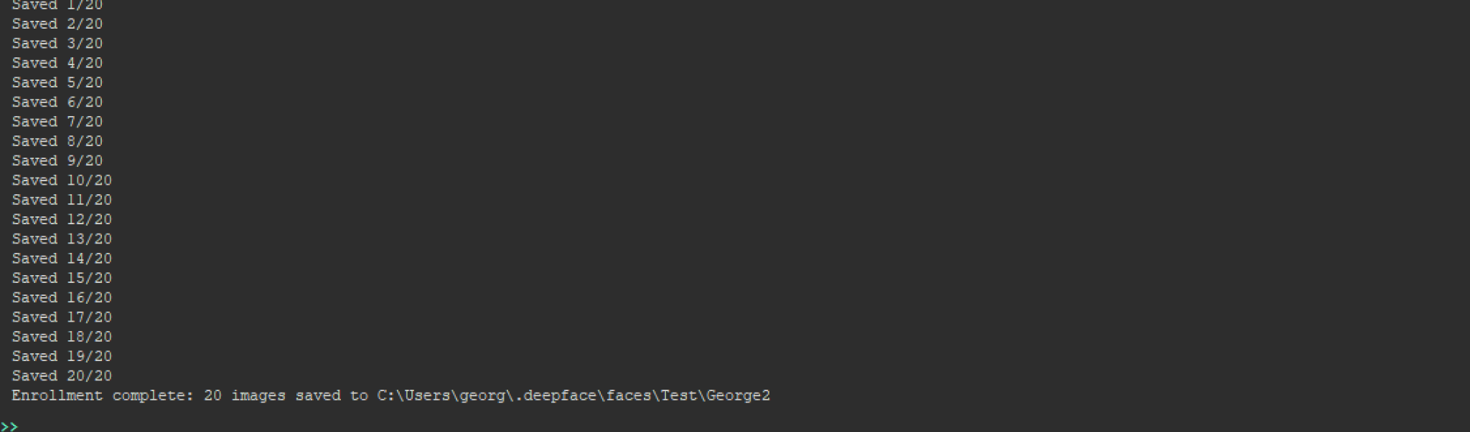
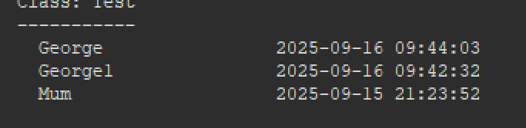
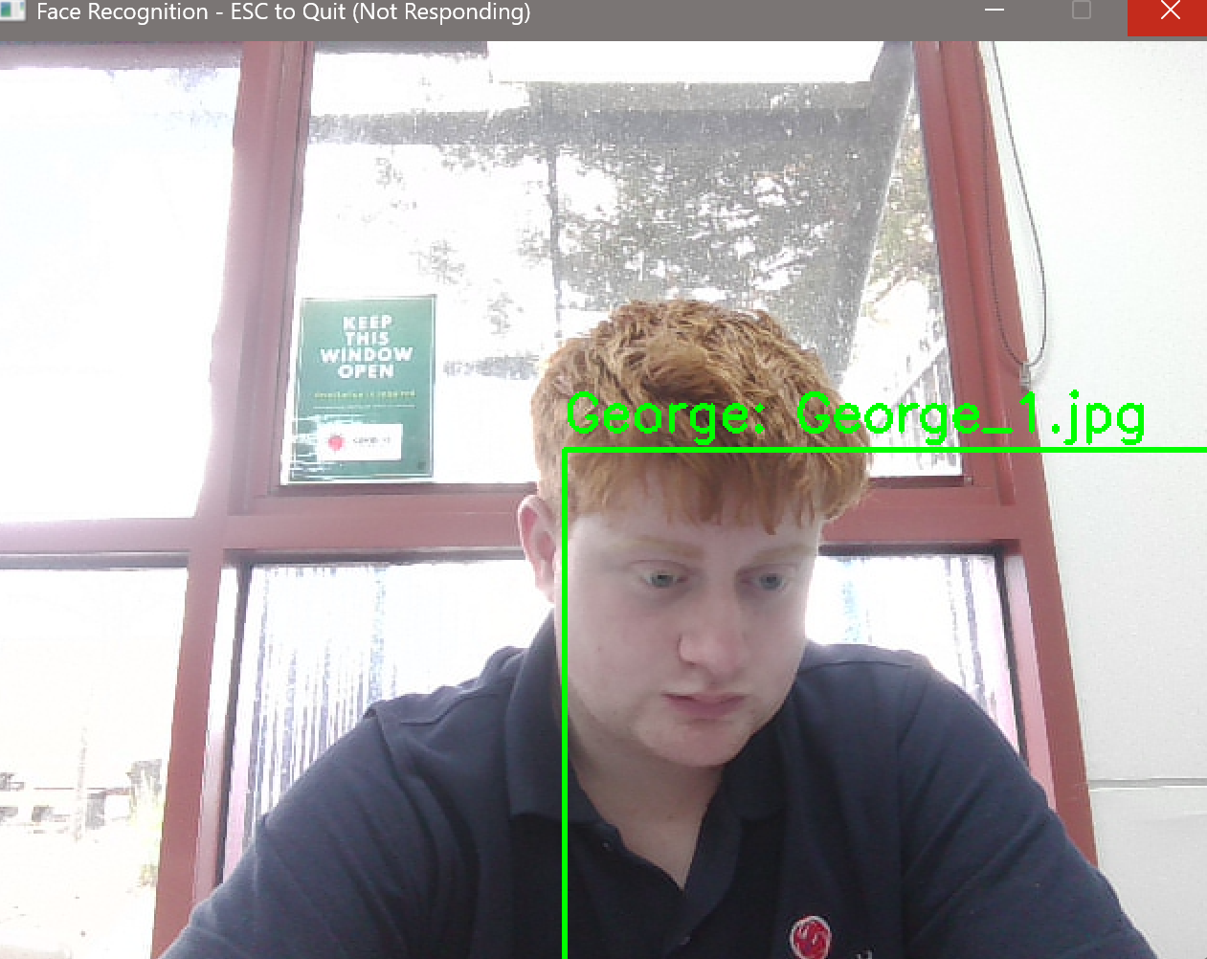
Final Class ID:
Our final product was built on thonny with the large help from AI and my family as test subjects:

Slide 23
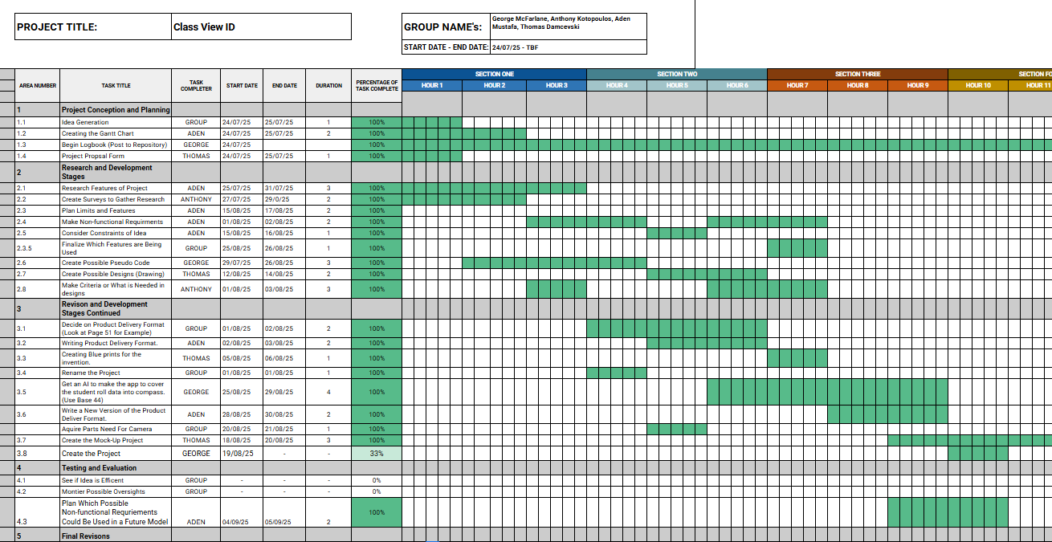
Finalised Gantt Chart:
Aden

Slide 24
Final Summary:
Aden
Overall, while we didn’t ultimately achieve goal of creating the fully working project. But, we do believe that we could of had our own fully working project, if not for the problems mentioned on the previous page.
Changes we would have made, and things we would have done differently:
Plan out the process more.
Plan out alternative options.
Decide to do something within our abilities, as to avoid spending unnecessary time learn how to do the task we set for ourselves.
Set a less vague time frame for ourselves. Meaning make it so specific tasks are done by a specific date, rather than leave it to be done within a general timeframe.
Communicate a little more.

Slide 25
Thank you for listening.
Thank you for listening.

